Slide 1
Project Service Automation
Microsoft Dynamics 365

Slide 2

Agenda
What is Project Service Automation ?
Why should we use it ?
Benefits
Modules of PSA
Configure PSA
Focused Entities
Example

Slide 3
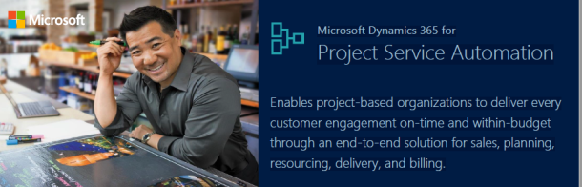
What is PSA ?
Project Service Automation(PSA) is an integrated suite of solutions built to enable Project-Based Organizations(PBOs) to manage services, from sales through invoicing.

Slide 4
Project Service is an end-to-end solution that extends Microsoft Dynamics 365 to provide a single system of customer engagement for project sales, resourcing, delivering and billing.
As PSA is built on Microsoft Dynamics 365, no integration will be required as it operates as one holistic solution. Because of this architecture, PSA enables billable project-based organizations to manage all aspects of client facing activities, from sales through project staffing, project delivery and invoicing.
The collaborative framework provided by PSA allows team members to work together to ensure customers and clients are satisfied, as well as maintain or exceed profit margin requirements.

Slide 5



Slide 6
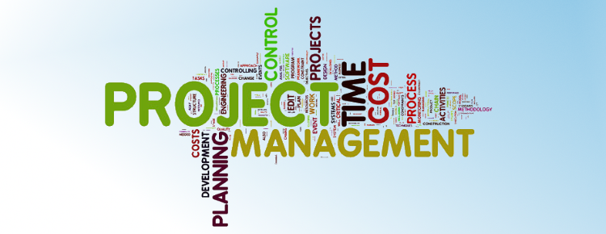
Project Service help us to:
Effectively estimate work
Forecast resource requirements when projects are in the pipeline
Enable team members to collaborate on projects and maintain current and accurate project status at all times
Proactively identify and resolve potential threats to the success of each and every engagement.

Slide 7
Benefits
Price to win in a complex organization
Dynamics 365 for PSA helps organizations to create competitive bids with resources from around the company, and with a solid understanding of the skills required, their cost, and the time to complete the work.
Quick-turnaround on project estimates
PSA offers project templates to enable organizations to more easily, and in much less time, create bids and reduce the cost of sales.
Assign the best available resources
One PSA’s greatest strengths is that of enabling organizations to find the right individuals, with the right availability and cost to begin project-based work when required.

Slide 8
Engage and develop professionals
Dynamics’ PSA’s architecture enables consultants and other billable employees to view upcoming project-based work, which allows them to potentially bid on the work.
Simplify timesheets and approvals
PSA offers intuitive calendar-based tracking and mobile application to improve the tedious task of maintaining project time and cost.
Invoice-as-agreed
Because PSA enables employees to record time and expenses through the solution or in the mobile app, it ensures that when invoices are generated, they will be transparent and accurate, increasing client satisfaction and reducing the potential for rejected invoices.

Slide 9
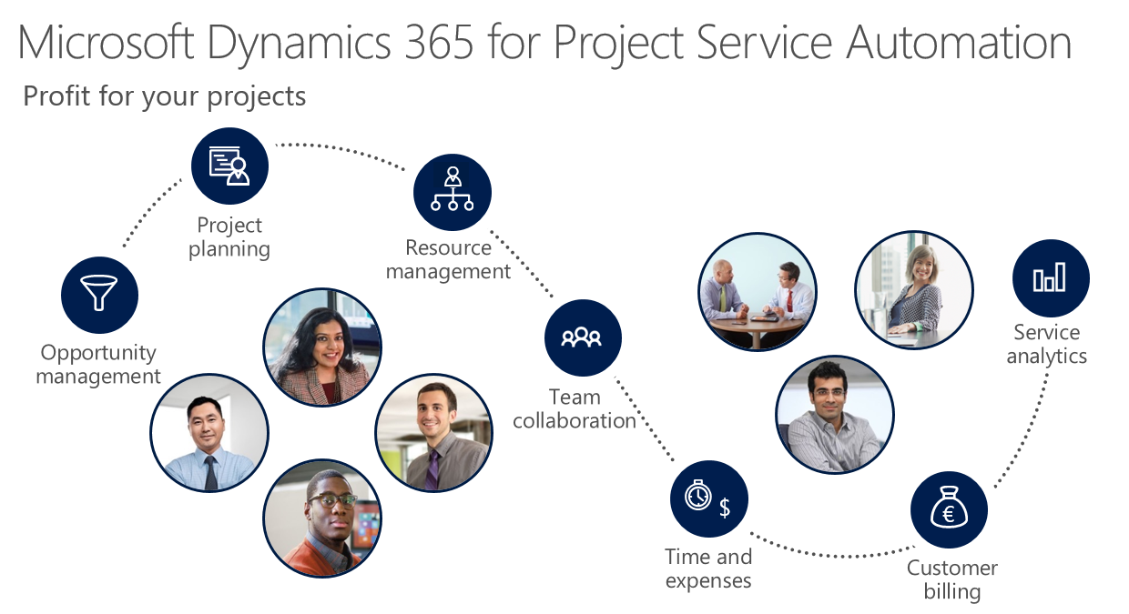
Modules of PSA

Slide 10
Opportunity management: An integrated dashboard that provides visibility into potential opportunities, their cost, duration and projected profit. This capability enables management to better understand the organizations pipeline.
Project planning: Enables sales and project managers to collaborate on the work proposed with the visualization of the cost, duration and value offered to the prospective customer or client.
Resource management: Provides visibility into the resources so that the best potential fit (skills, cost, availability, etc.) can be brought in to the project work.
Team collaboration: During project execution provides a collaborative environment for team members to share information and collaborate on project deliverables.

Slide 11
Time and expenses management: Enables individual consultants to accurately track their project time and expenses related to specific tasks and deliverables to maintain cost control within the project-based work.
Customer billing: Allows project managers to track, review and update and approve all project related costs followed by invoice generation and emailed to the customer. This capability is integrated with leading financial solutions.
Service analytics: Interactive dashboards provide the infrastructure for management to understand all aspects of the projects delivered, their success, cost, revenue and other critical key performance indicators necessary to successfully run a project-based business.

Slide 12
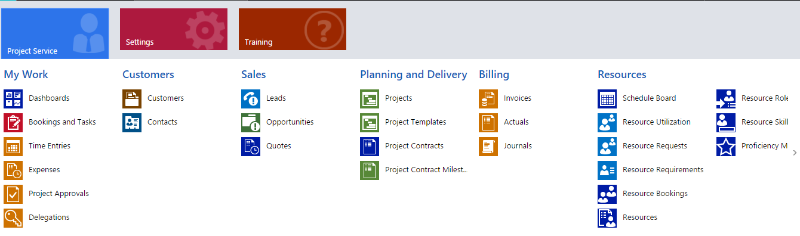
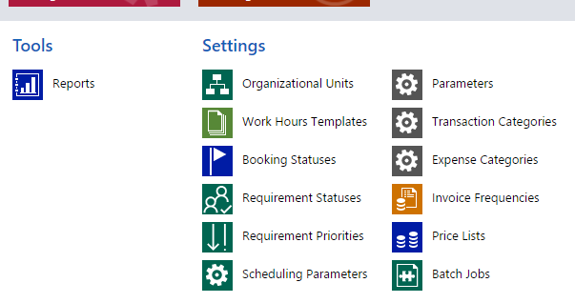
PSA Entities

Slide 13
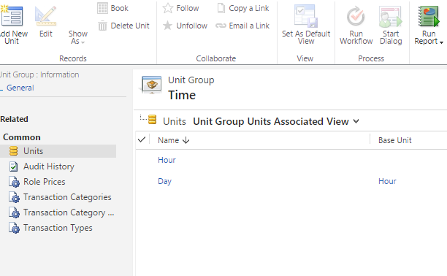
Configure PSA
Set up time units : Configure the time units in the product catalog that you’ll use as a base for scheduling and billing your projects.
Go to Settings > Product Catalog > Unit Groups > Time

Slide 14
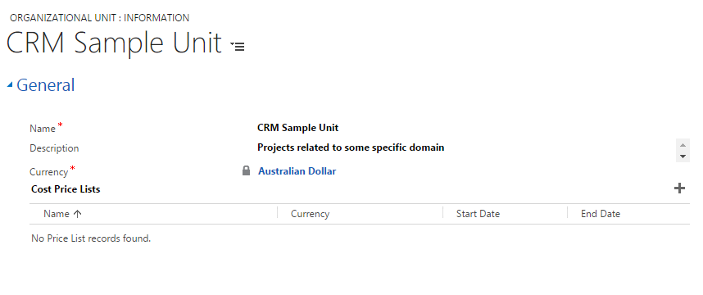
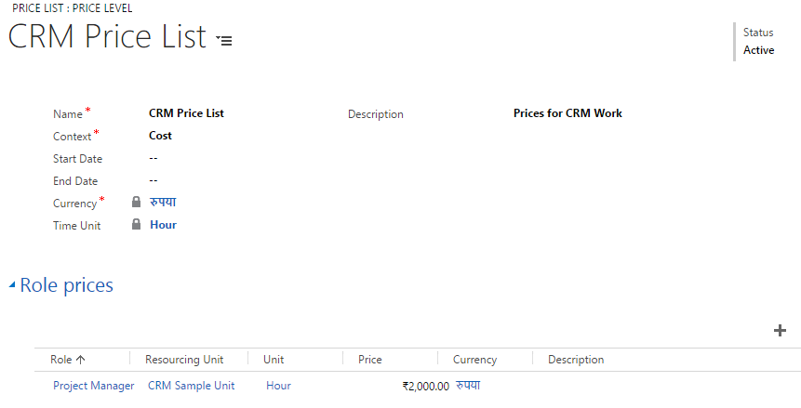
Set up currencies and exchange rates: Set up the currencies to use for your projects.
Create organizational units : Set up the groups that your company uses to divide its business, whether by geography, business function, or other logical division.

Slide 15
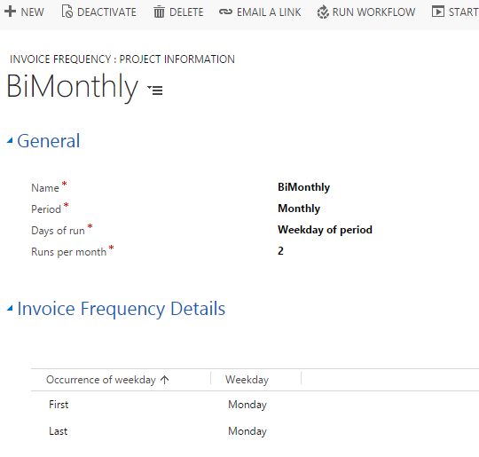
Set up invoice frequencies : Set up time periods that you want to use for billing your clients.

Slide 16
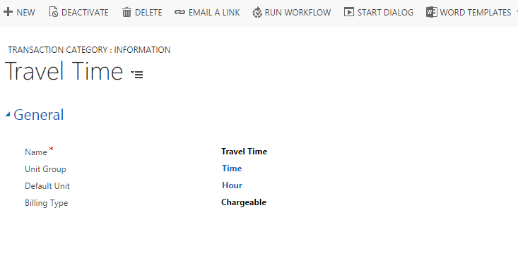
Configure transaction categories : Set up transaction categories your consultants can charge their billable and unbillable expenses to.

Slide 17
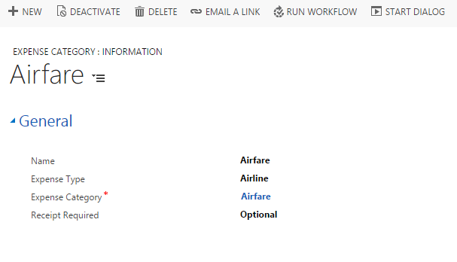
Configure expense categories : Set up the categories your consultants can charge their billable and unbillable expenses to.

Slide 18
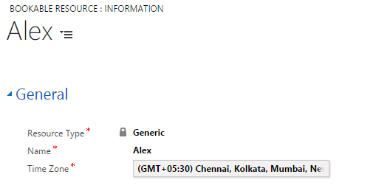
Create product catalog items : Add the products you sell, such as software licenses, to the product catalog.
Create a price list : Configure different price lists, depending on how much you want to charge your clients for each role their project requires.
Set up resources : Add the skills, proficiencies, resource roles, and other resource information that you’ll need for your projects.

Slide 19
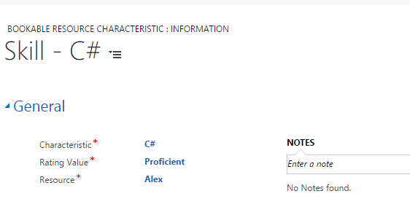
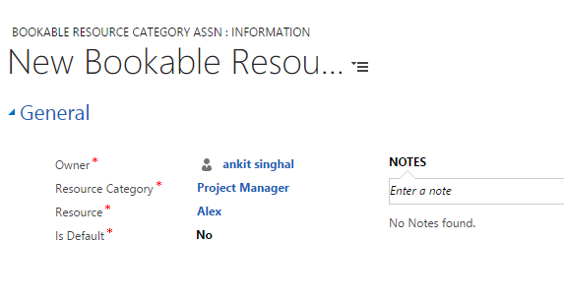
Add the Skills and Category for the Resource:

Slide 20
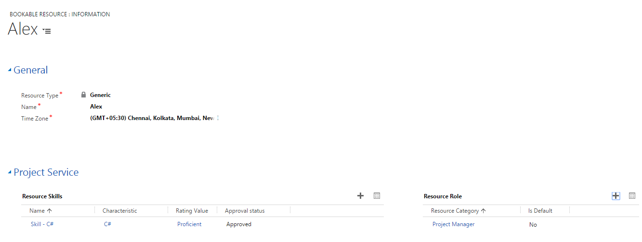
Finally, the Bookable Resource with all relevant information in one form :

Slide 21
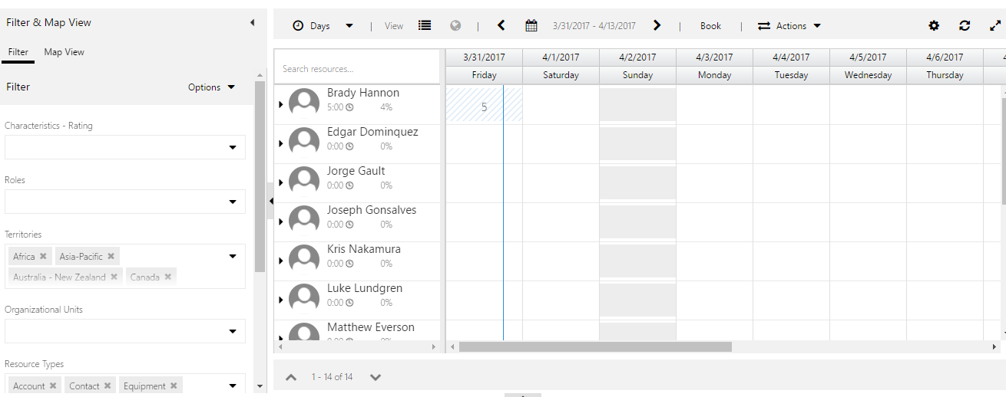
Focused Entities
Schedule Board: It shows list of resources and their availability.

Slide 22
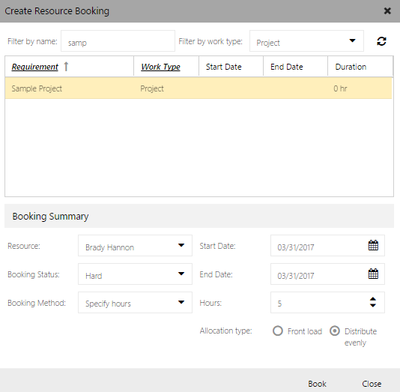
Assign resources to projects:

Slide 23
Resource requests: Match the skills and proficiencies of your consultants to the right projects.
Resource availability : Check consultants’ availability in a calendar view.
Resource utilization: See the percentage of time that your consultants are currently booked.
Schedule resources for a project: Schedule consultants for a project.

Slide 24
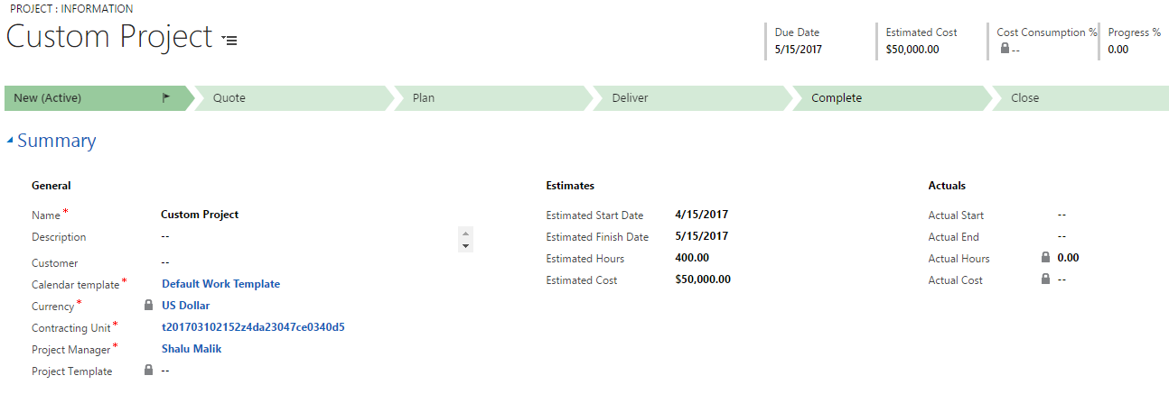
Example
Go to Project Service Area -> Projects
Fill the mandatory details.

Slide 25
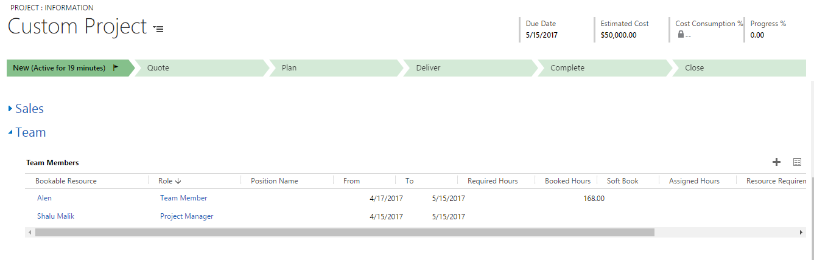
Increase the quantity of your Team by adding resources to the project.

Slide 26
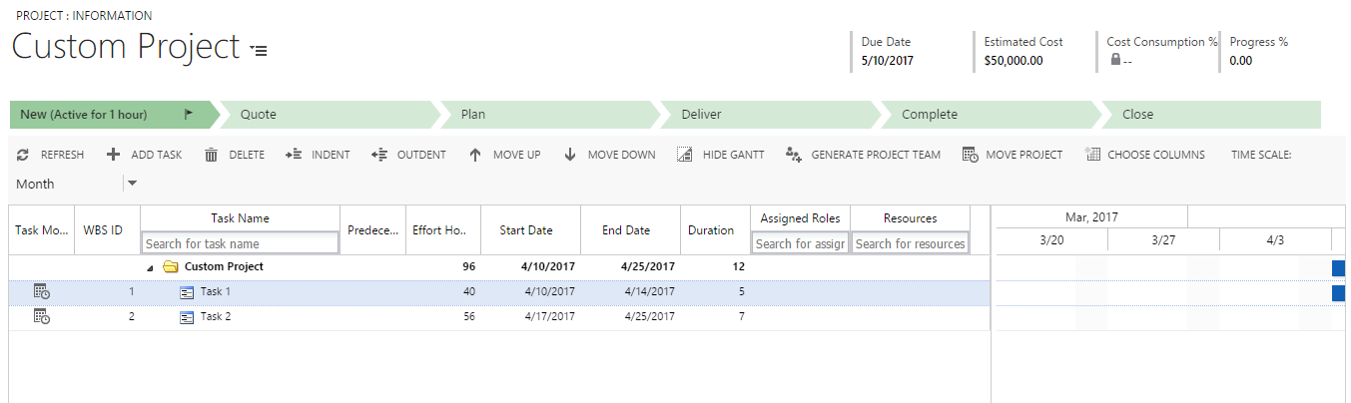
Create Work Breakdown Structure (WBS) for the Project:

Slide 27
Conclusion
Project Service Automation is great addition to the Microsoft Dynamics family. The fact that it is developed on Microsoft Dynamics platform makes it a clear choice for those project-based organizations that desire greater sales and service delivery alignment.
The fact that it is integrated with the other Microsoft products, including Microsoft Office 365, enhances Project-Based Organizations(PBOs) ability to plan, sell, and execute project-based services.
Every team member will have visibility and access to their specific obligations, making it much easier to complete work.

Slide 28


